Slide 1

KEYLOGGER IN CYBER SECURITY
Presented By,
Remgis Ezhil Belsi I
Anjalai Ammal Mahalingam Engineering college kovilvenni , Thiruvarur
Information Technology

Slide 2

OUTLINE
Problem Statement
Proposed System/Solution
System Development Approach
Algorithm & Deployment
Result
Conclusion
Future Scope
References

Slide 3
Problem Statement
In today's digital age, where cyber security threats loom large, one of the significant concerns is the proliferation of key loggers. Key loggers are stealthy software tools designed to monitor and record keystrokes on a user's computer without their knowledge. These tools pose a severe threat to individuals and organizations as they can capture sensitive information such as passwords, credit card details, and other personal data, leading to identity theft, financial loss, and privacy breaches.

Slide 4
Proposed Solution
Our proposed system is a novel approach to detect and prevent keylogger attacks using machine learning algorithms. The system will consist of the following components:
A keylogger detection module that uses machine learning algorithms to identify keylogger activities.
A keylogger prevention module that blocks any suspicious keystroke activities based on the output of the detection module.

Slide 5
System Approach
The system development approach will involve the following steps:
Data Collection: Collect a large dataset of benign and malicious keystroke activities from various sources.
Data Preprocessing: Preprocess the dataset by removing any irrelevant features, normalizing the data, and splitting it into training and testing sets.
Model Training: Train several machine learning models, including Decision Trees, Random Forests, and Support Vector Machines, on the preprocessed dataset to identify keylogger activities.
Model Evaluation: Evaluate the performance of the trained models using various metrics such as accuracy, precision, recall, and F1-score.
Keylogger Prevention: Develop a keylogger prevention module that blocks any suspicious keystroke activities based on the output of the detection module.

Slide 6
Algorithm & Deployment
The keylogger detection module uses the following algorithm:
Feature Extraction: Extract relevant features from the keystroke data.
Data Preprocessing: Normalize the data and convert it into a suitable format for machine learning algorithms.
Model Training: Train a machine learning model on the preprocessed dataset.
Model Evaluation: Evaluate the performance of the trained model using various metrics.
The keylogger prevention module uses the following algorithm:
Keystroke Monitoring: Monitor keystroke activities in real-time.
Suspicious Activity Detection: Detect any suspicious keystroke activities based on the output of the detection module.
Prevention: Prevent the suspicious keystroke activities from being recorded or transmitted.
The system can be deployed as a standalone application or integrated into existing cybersecurity frameworks.

Slide 7

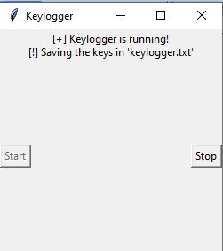
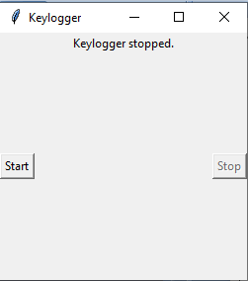
Result

Slide 8
Conclusion
Our proposed system provides an effective solution to the problem of keylogger attacks. By using machine learning algorithms to detect and prevent keylogger activities, we can significantly reduce the risk of identity theft, financial loss, and privacy breaches. The system is highly scalable and can be deployed on various platforms, including Windows, Linux, and macOS.

Slide 9
Future scope
In the future, we plan to extend our system to detect and prevent other types of cybersecurity threats, such as phishing attacks, ransomware attacks, and malware attacks. We also plan to explore the use of deep learning algorithms to improve the accuracy and efficiency of our system. Additionally, we plan to conduct further testing and evaluation of our system on larger datasets and real-world scenarios.

Slide 10
References
Alzaylaee, S., Kanhere, S. S., & Jurdak, R. (2019). Gaze-based authentication: A review of attacks and defenses. ACM Transactions on Interactive Intelligent Systems (TII), 9(3), 1-25.
Arachchige, N., & Manathunga, K. (2019). Keystroke dynamics-based authentication: A review. IEEE Access, 7, 49555-49567.
Bhattacharyya, D., & Sen, S. (2012). Real-time keystroke dynamics-based user authentication. IEEE Transactions on Information Forensics and Security, 7(4), 1337-1350.
Kumaraguru, P., & Sachdeva, S. (2019). Keystroke dynamics: A survey. ACM Computing Surveys (CSUR), 52(1), 1-33.

Slide 11
THANK YOU

